Slide 1
PROBABILITY AND STATISTICS
WEEK 1
Onur Doğan-2016/2017

Slide 2
What is Statistics?
The science of collecting, describing, analyzing and interpreting data.
Onur Doğan

Slide 3
What is Statistics?
Descriptive Statistics: collection, presentation, and description of sample data.
Inferential Statistics: making decisions and drawing conclusions about populations.
Onur Doğan

Slide 4
Basic Terms
Population: A collection, or set, of individuals or objects or events whose properties are to be analyzed.
Two kinds of populations: finite or infinite.
Sample: A subset of the population.
Variable: A characteristic about each individual element of a population or sample.
Data (singular): The value of the variable associated with one element of a population or sample. This value may be a number, a word, or a symbol.
Data (plural): The set of values collected for the variable from each of the elements belonging to the sample.
Experiment: A planned activity whose results yield a set of data.
Parameter: A numerical value summarizing all the data of an entire population.
Statistic: A numerical value summarizing the sample data.
Onur Doğan

Slide 5
Example: A college dean is interested in learning about the average age of faculty. Identify the basic terms in this situation.
The population is the age of all faculty members at the college.
A sample is any subset of that population. For example, we might select 10 faculty members and determine their age.
The variable is the “age” of each faculty member.
One data would be the age of a specific faculty member.
The data would be the set of values in the sample.
The experiment would be the method used to select the ages forming the sample and determining the actual age of each faculty member in the sample.
The parameter of interest is the “average” age of all faculty at the college.
The statistic is the “average” age for all faculty in the sample.

Slide 6

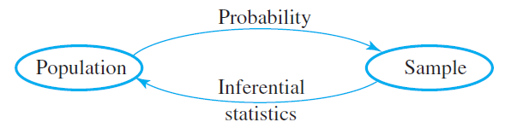
Onur Doğan

Slide 7
Level of Measurement
Nominal Scale
In this scale, we attempt to sort elements with respect to a certain characteristic, making decisons about which elements are most similar and which most different.
Ordinal Scale
In this scale we are able to not only to group units into seperate categories but also to order the categories as well.
Interval Scale
Is it possible to indicate the exact distance between variables.
Ratio Scale
Zero means absence.
Onur Doğan

Slide 8
Level of Measurement
Nominal Scale (Classifications, Set memberships, etc.)
Birth place, sex, etc
Ordinal Scale (Ordinal data)
Education level, etc.
Interval Scale (Equal distances but no zero point)
Temparature, etc.
Ratio Scale (Absolute zero)
Age, income, etc.
Onur Doğan

Slide 9
Data Presentation
Basic Presentation
Frequency Distributions
Relative Frequency Distributions
Presentations by Classes
Stem and Leaf Display
Graphical Presentations
Histograms, Frequency Polygons, Pie Charts, etc.
Onur Doğan

Slide 10
Example
Example: The hemoglobin test, a blood test given to diabetics during their periodic checkups, indicates the level of control of blood sugar during the past two to three months. The data in the table below was obtained for 40 different diabetics at a university clinic that treats diabetic patients:
6.5 5.0 5.6 7.6 4.8 8.0 7.5 7.9 8.0 9.2
6.4 6.0 5.6 6.0 5.7 9.2 8.1 8.0 6.5 6.6
5.0 8.0 6.5 6.1 6.4 6.6 7.2 5.9 4.0 5.7
7.9 6.0 5.6 6.0 6.2 7.7 6.7 7.7 8.2 9.0
1) Construct a grouped frequency distribution using the classes
3.7 - <4.7, 4.7 - <5.7, 5.7 - <6.7, etc.
2) Which class has the highest frequency?

Slide 11
Solutions
1)
Class Frequency Relative Cumulative Class
Boundaries f Frequency Rel. Frequency Midpoint, x
---------------------------------------------------------------------------------------
3.7 - <4.7 1 0.025 0.025 4.2
4.7 - <5.7 6 0.150 0.175 5.2
5.7 - <6.7 16 0.400 0.575 6.2
6.7 - <7.7 4 0.100 0.675 7.2
7.7 - <8.7 10 0.250 0.925 8.2
8.7 - <9.7 3 0.075 1.000 9.2
2) The class 5.7 - <6.7 has the highest frequency. The frequency is 16 and the relative frequency is 0.40

Slide 12
Stem & Leaf Display
The stem-and-leaf display has become very popular for summarizing numerical data
It is a combination of graphing and sorting
The actual data is part of the graph
Well-suited for computers
Stem-and-Leaf Display: Pictures the data of a sample using the actual digits that make up the data values. Each numerical data is divided into two parts: The leading digit(s) becomes the stem, and the trailing digit(s) becomes the leaf. The stems are located along the main axis, and a leaf for each piece of data is located so as to display the distribution of the data.

Slide 13
Example
Example: A city police officer, using radar, checked the speed of cars as they were traveling down the main street in town. Construct a stem-and-leaf plot for this data:
41 31 33 35 36 37 39 49
33 19 26 27 24 32 40
39 16 55 38 36
Solution:
All the speeds are in the 10s, 20s, 30s, 40s, and 50s. Use the first digit of each speed as the stem and the second digit as the leaf. Draw a vertical line and list the stems, in order to the left of the line. Place each leaf on its stem: place the trailing digit on the right side of the vertical line opposite its corresponding leading digit.

Slide 14
Example
---------------------------------------
1 | 6 9
2 | 4 6 7
3 | 1 2 3 3 5 6 6 7 8 9 9
4 | 0 1 9
5 | 5
----------------------------------------
The speeds are centered around the 30s
Note: The display could be constructed so that only five possible values (instead of ten) could fall in each stem. What would the stems look like? Would there be a difference in appearance?

Slide 15
Histogram
Histogram: A bar graph representing a frequency distribution of a quantitative variable. A histogram is made up of the following components:
1. A title, which identifies the population of interest
2. A vertical scale, which identifies the frequencies in the various classes
3. A horizontal scale, which identifies the variable x. Values for the class boundaries or class midpoints may be labeled along the x-axis. Use whichever method of labeling the axis best presents the variable.
Notes:
The relative frequency is sometimes used on the vertical scale.
It is possible to create a histogram based on class midpoints.

Slide 16
Example
Example: A recent survey on people’s age in a spesific village summarized and given in the table below. Construct a histogram for this age data:
Age Frequency Class Midpoint
------------------------------------------------------------
20 up to 30 34 25
30 up to 40 58 35
40 up to 50 76 45
50 up to 60 187 55
60 up to 70 254 65
70 up to 80 241 75
80 up to 90 147 85

Slide 17
Solution
Age
2
0
0
Frequency
1
0
0
0
2
5
3
5
4
5
5
5
6
5
7
5
8
5
Age

Slide 18
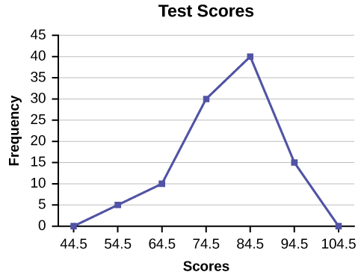
Frequency Polygon
An example for frequency polygon
Onur Doğan

Slide 19
Example
Example: The table below lists the number of automobiles sold last week by day for a local dealership. Describe the data using a circle graph and a bar graph:
Day
Number Sold
Monday
15
Tuesday
23
Wednesday
35
Thursday
11
Friday
12
Saturday
42

Slide 20
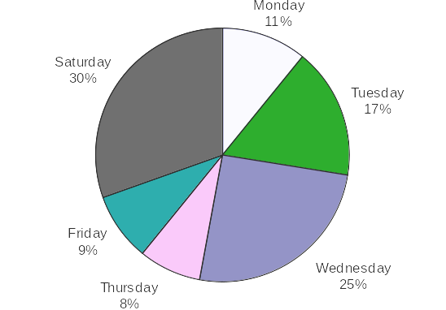
Circle Graph Solution
Automobiles Sold Last Week

Slide 21
Measures of Central Tendency
Mean (Arithmetic, Geometric, Squared, etc.)
Median
Mode
Onur Doğan

Slide 22
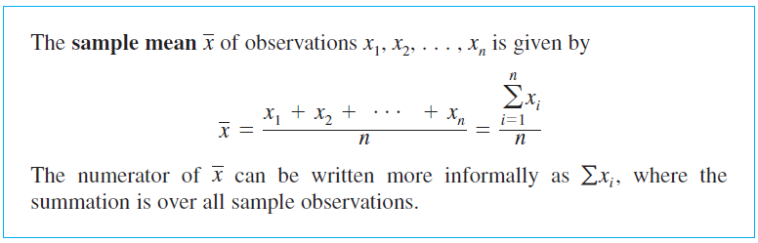
Mean
Onur Doğan

Slide 23

Mean
Since frequency shows the value of the occurence of a variable mean formula for frequency distributions becomes;
Note:
We should write midpoints of the intervals to find the mean of grouped data.
Onur Doğan

Slide 24
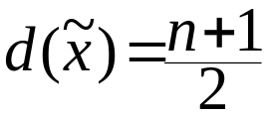
Median
Median: The value of the data that occupies the middle position when the data are ranked in order according to size
To find the median:
1. Rank the data
2. Determine the depth of the median:
3. Determine the value of the median
Onur Doğan

Slide 25
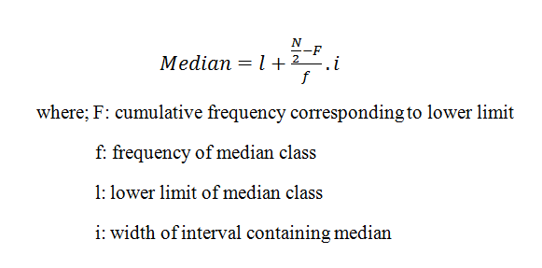
Median
Median formula for grouped data;
Onur Doğan

Slide 26
Mode
Mode: The mode is the value of x that occurs most frequently
Note: If two or more values in a sample are tied for the highest frequency (number of occurrences), there is no mode
Onur Doğan

Slide 27
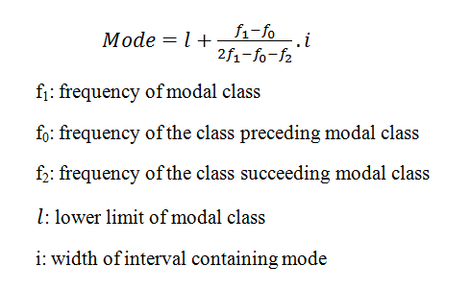
Mode
Mode formula for grouped data;
Onur Doğan

